Slide 1
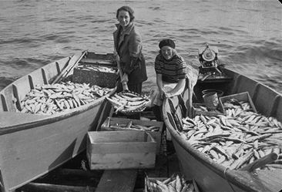

Lake Superior Ciscoe Recruitment Dynamics
Coregonus Cisco
Lake Superior, USA
Data from USGS (historic), WI DNR (recent)
The Nature Conservancy
Great Lakes Sustainable Fisheries Annual Review & Celebration
September 12 – 13 | Duluth, MN
Notes:
This is not just a historical tale about the past. Exploitation and recruitment dynamics are a current issue. The fishery was able to sustain high fishing pressure for a long time, nearly 30 years. But then it did crash. Eventually Cisco populations appear to have recovered but we don’t know how recovered they are in relation to historical populations. The present fishery has been driven by demand for roe that is sold in Scandinavia. The harvest and effort is much lower than that seen from 1930-1962.

Slide 2
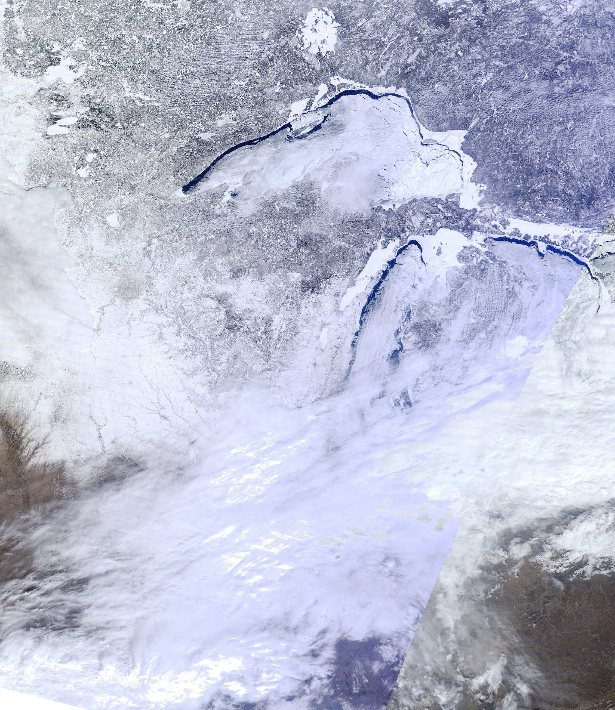
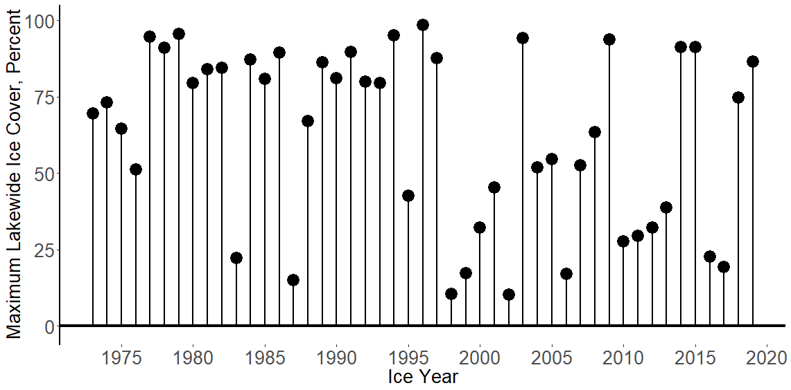
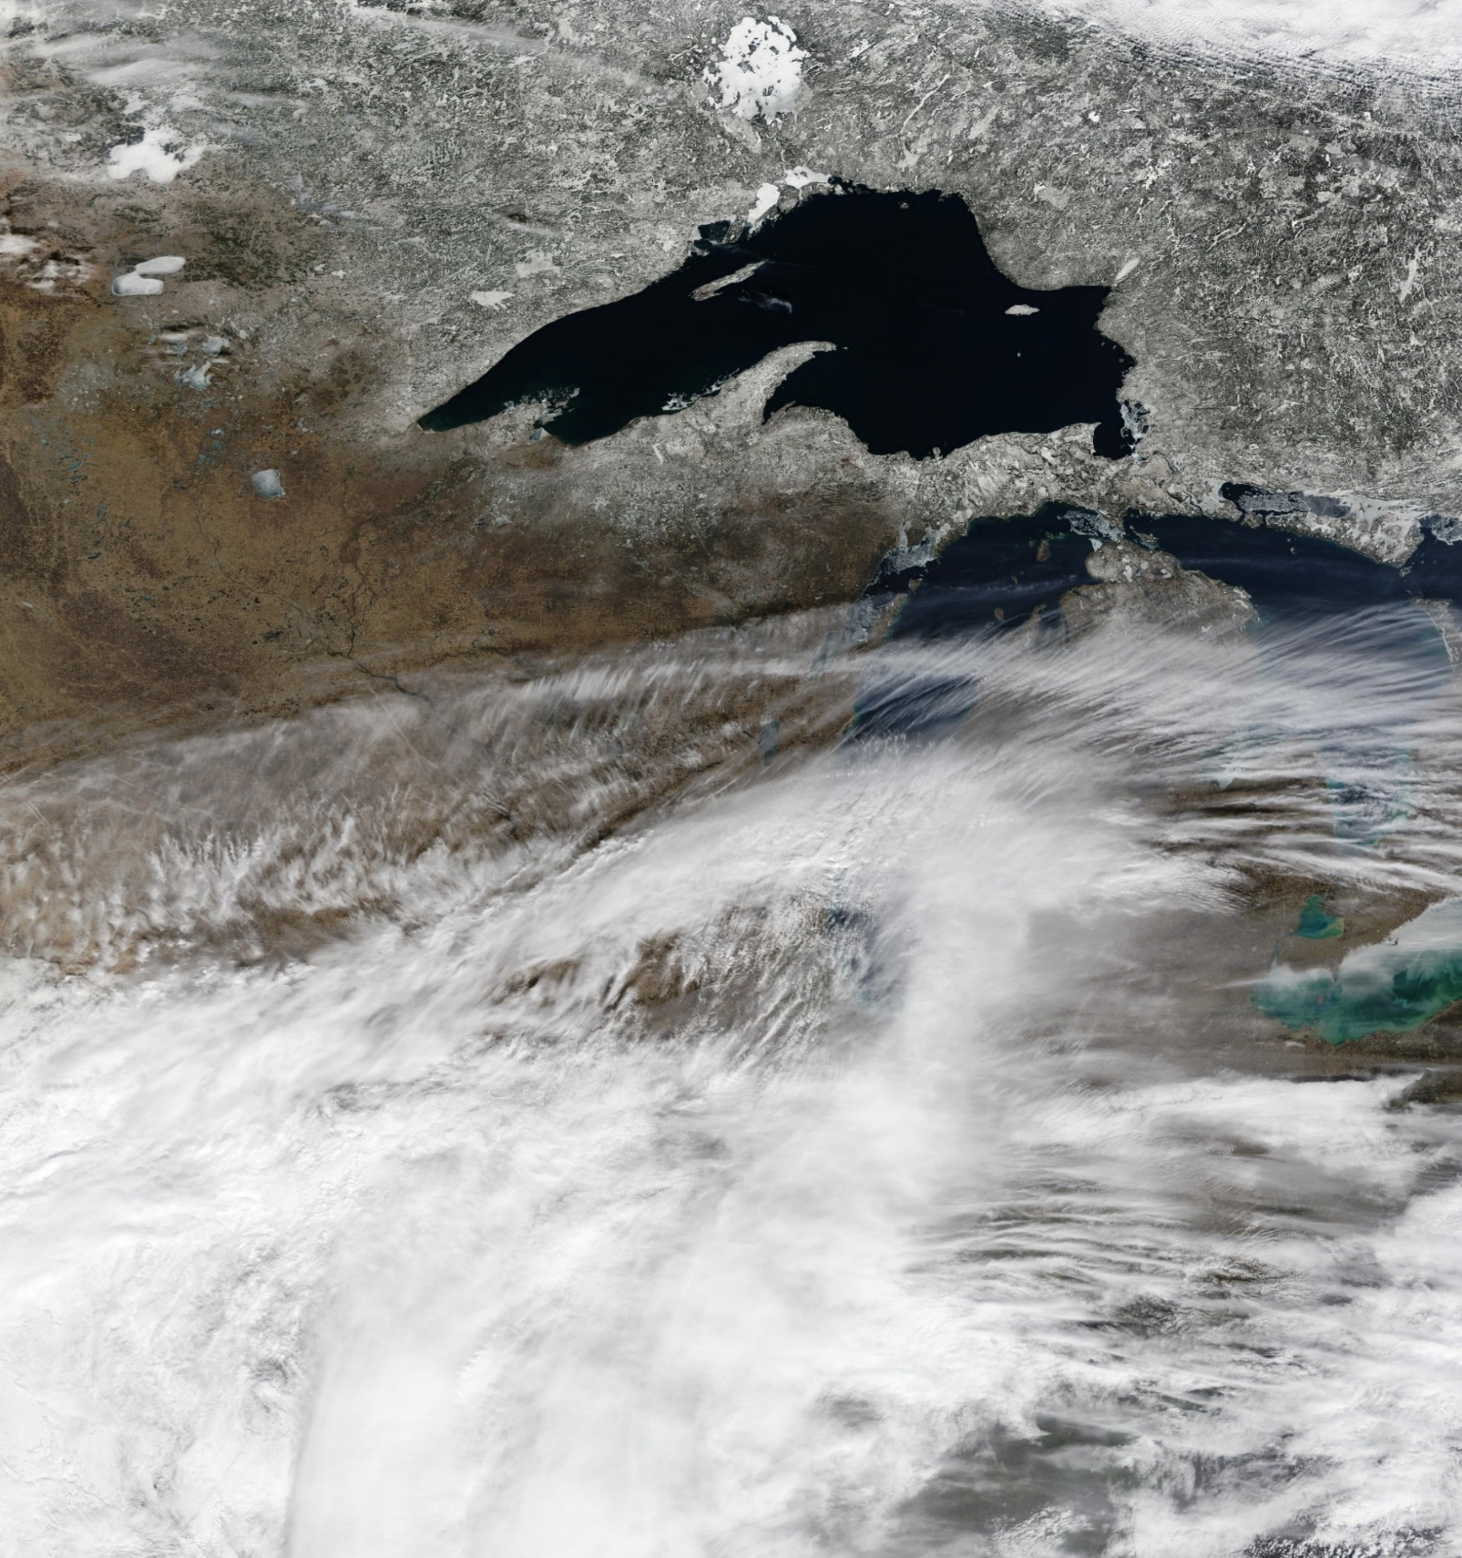
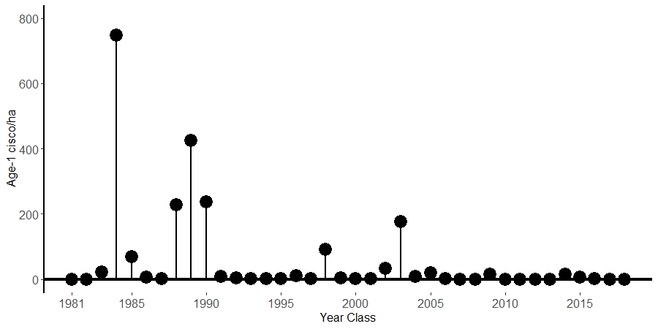


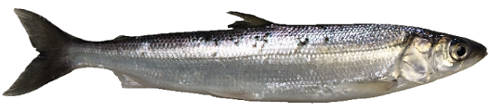
Lake Superior Ice
12 March 2014
12 March 2016
Cisco Recruitment
Cisco-1
Anybody out there?
Satellite images from UW-Madison. Ice data from NOAA GLERL. Fish data from USGS Lake Superior nearshore fish surveys

Slide 3
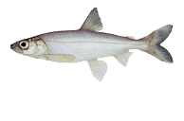
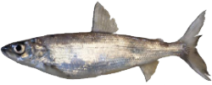
Lake Superior Ciscoe Population Dynamics
25 year life span
Data from USGS Lake Superior nearshore fish surveys

Slide 4
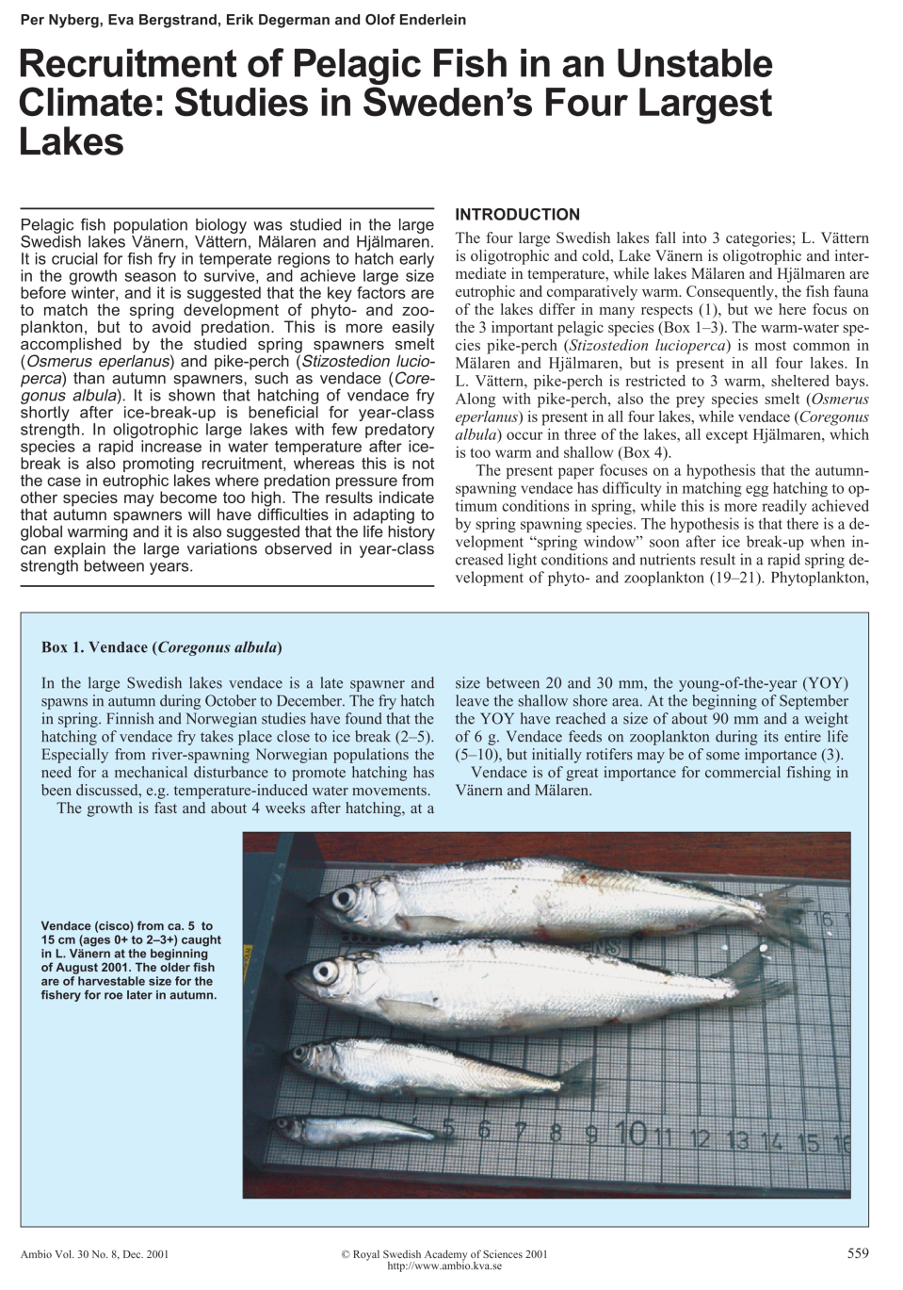
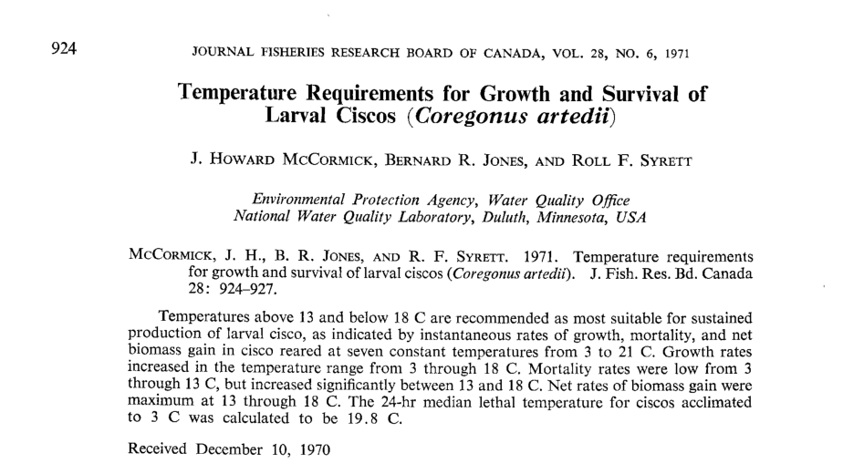
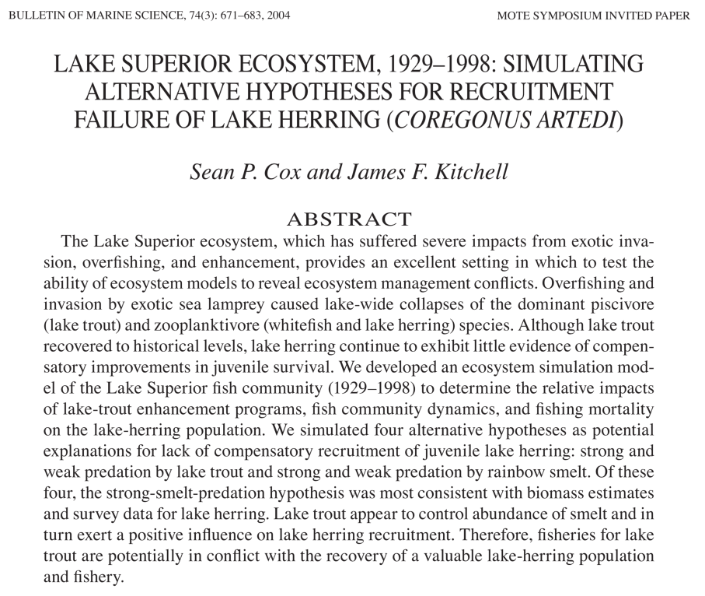
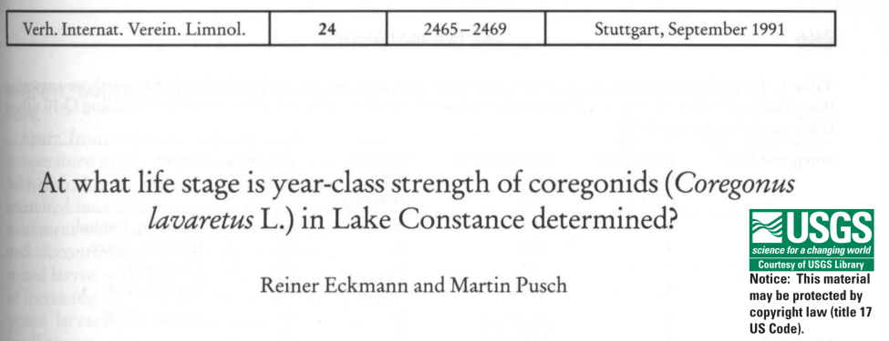
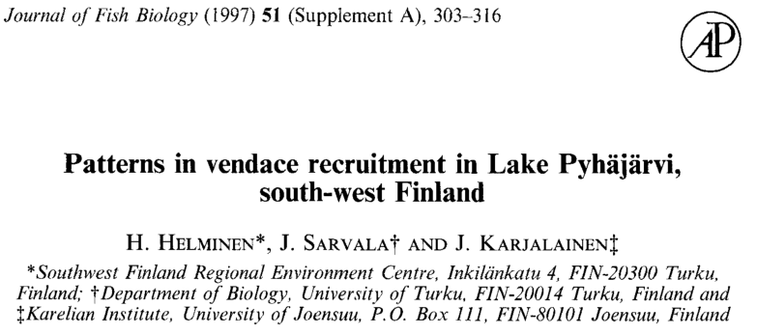

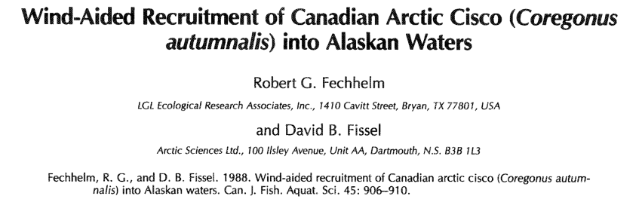
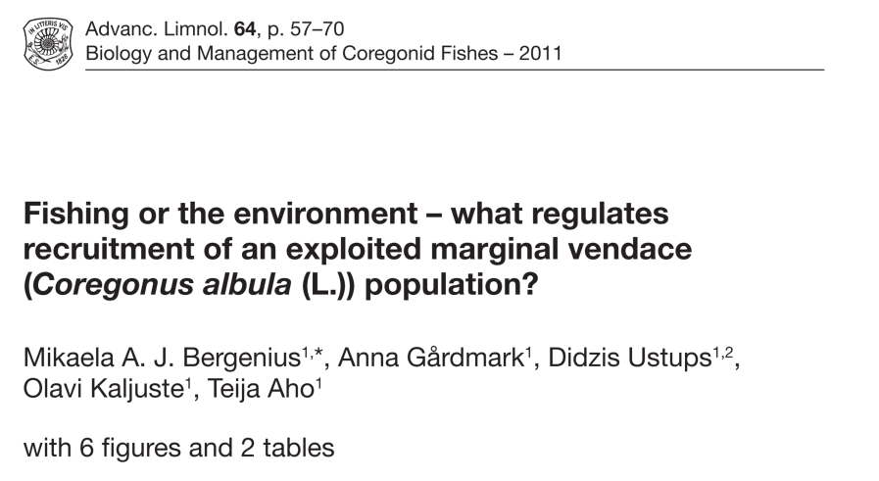
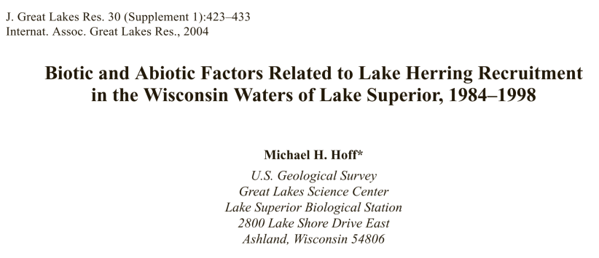
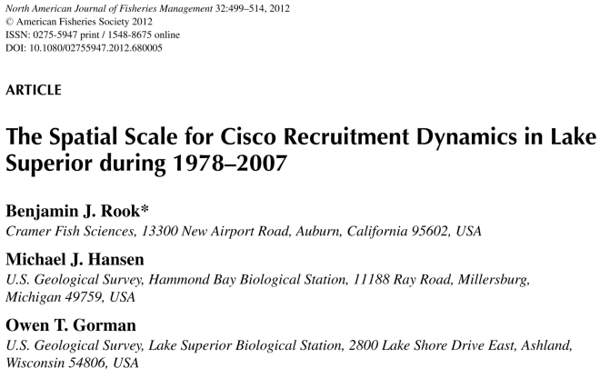
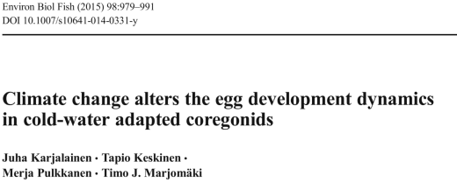
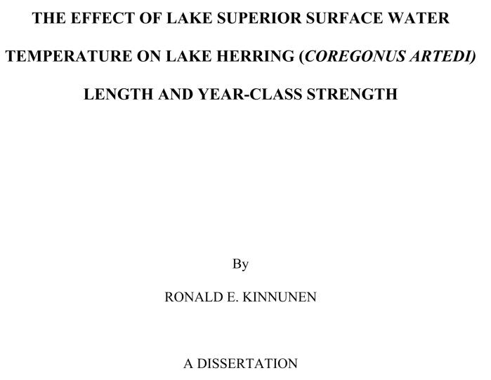
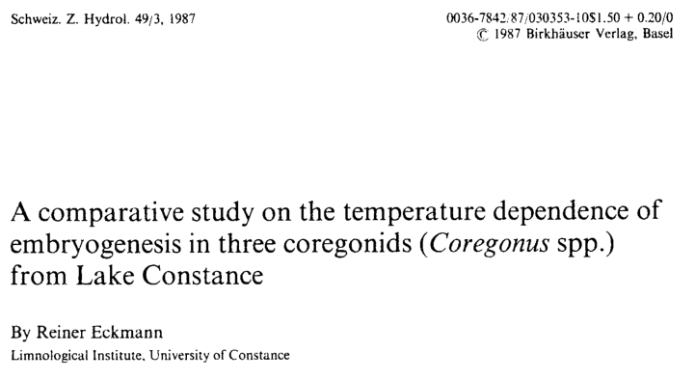

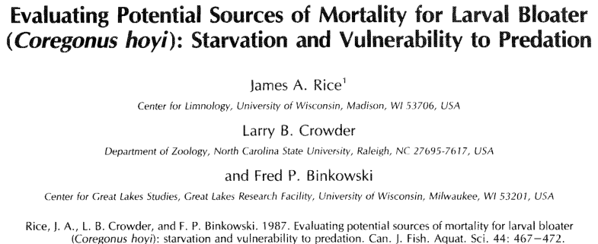
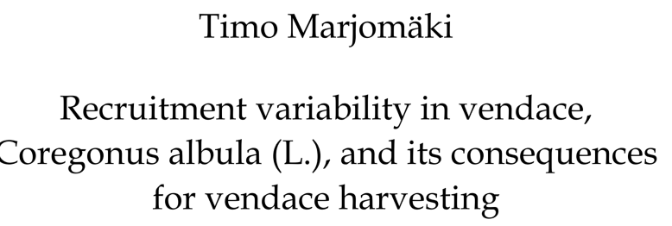
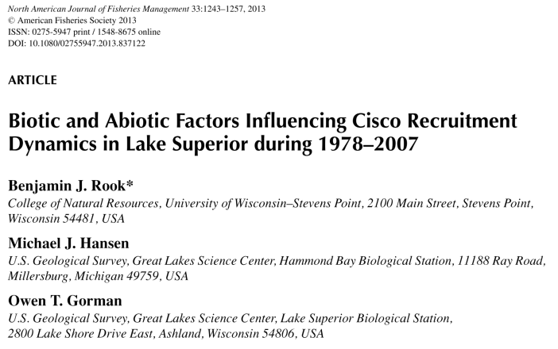
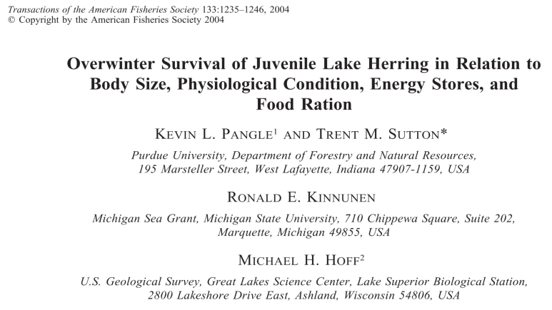
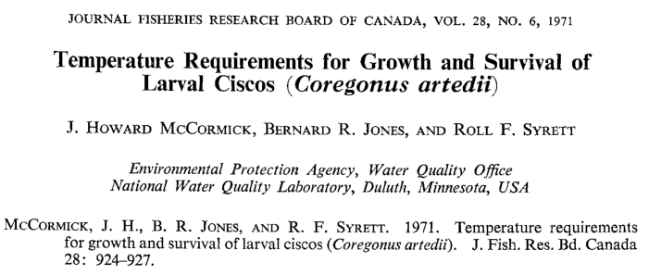

Slide 5
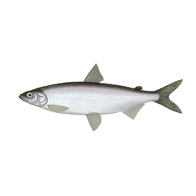
Lake Superior Ice Cover and Ciscoe Recruitment Relationship
1984
April 1st
1989
1988
1990
2003
1998
1985
2014
2015
Lake Superior data from USGS Lake Superior nearshore fish surveys, Canadian Ice Service. Lake Mälaren data from Nyberg 2001.

Slide 6
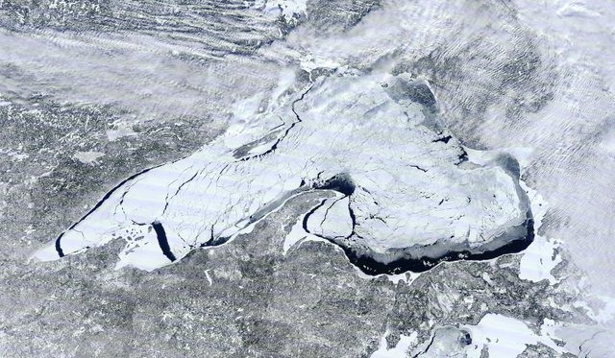

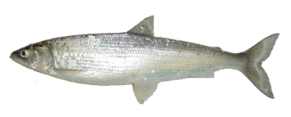





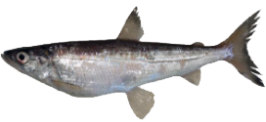
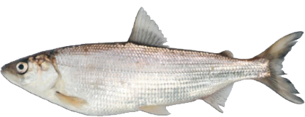
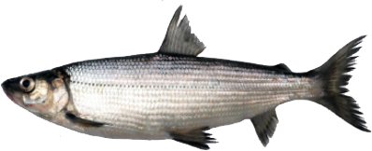
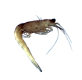


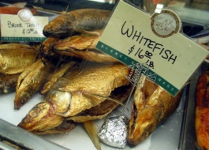

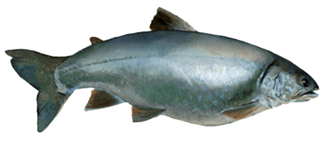
Cisco
Lake Superior Cisco
Partnership
Separated
Divorced
It’s complicated
Relationship with Ice Cover
Relationship Status
Family Members
Bloater
Kiyi
Shortjaw
Blackfin
GL Fishers
Mark Vinson
Kiyi
New York Deli’s
TNC
Lake Trout
Mysis

Slide 7
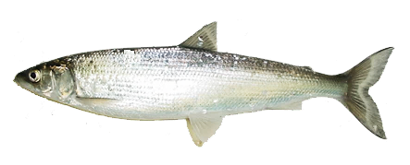

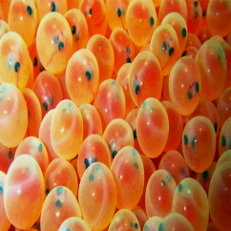
Can we develop a model that identifies what factors underlie the variability in survival to age-1?
Adult Spawning
Population size
Health / fecundity
Larval stage
Growth
Predation
Temperature
Egg Incubation
Ice Cover
Temperature
Predation

Slide 8
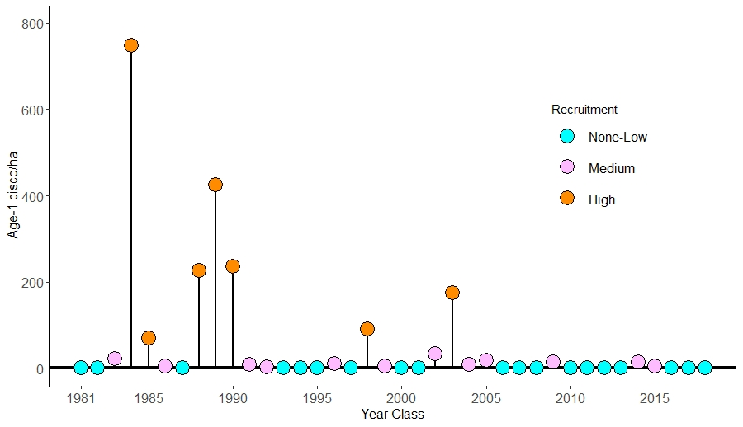
Lake Superior Ciscoe age-1 Recruitment Predictive Model
Recruitment group | Years | Index value
None-Low | 19 | <2 fish / ha
Measurable | 12 | 3-33 fish / ha
High | 7 | 68-750 fish / ha
Possible factors explaining recruitment
Factor 1
yes
no
low
medium & high
Factor 2
yes
no
medium
high
Data from USGS Lake Superior nearshore fish surveys
Notes:
What conditions promote high recruitment events? This is an analysis that has been done for 30 years with relative levels of success. While this is a wicked problem, successful recruitment events are not purely random. So in this latest attempt, we took a predictive decision tree modeling approach and we first broke the data into three classes based on the distribution of the population.

Slide 9
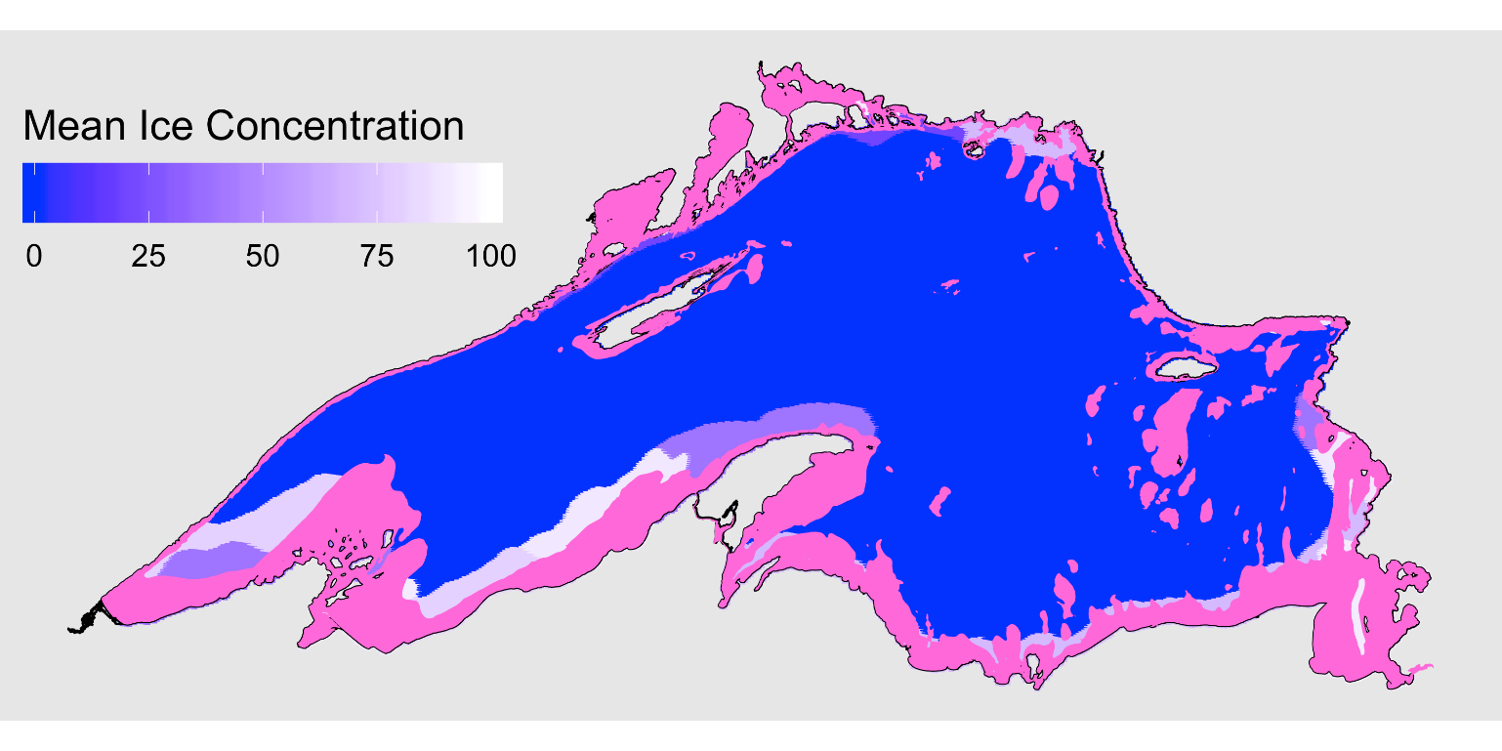
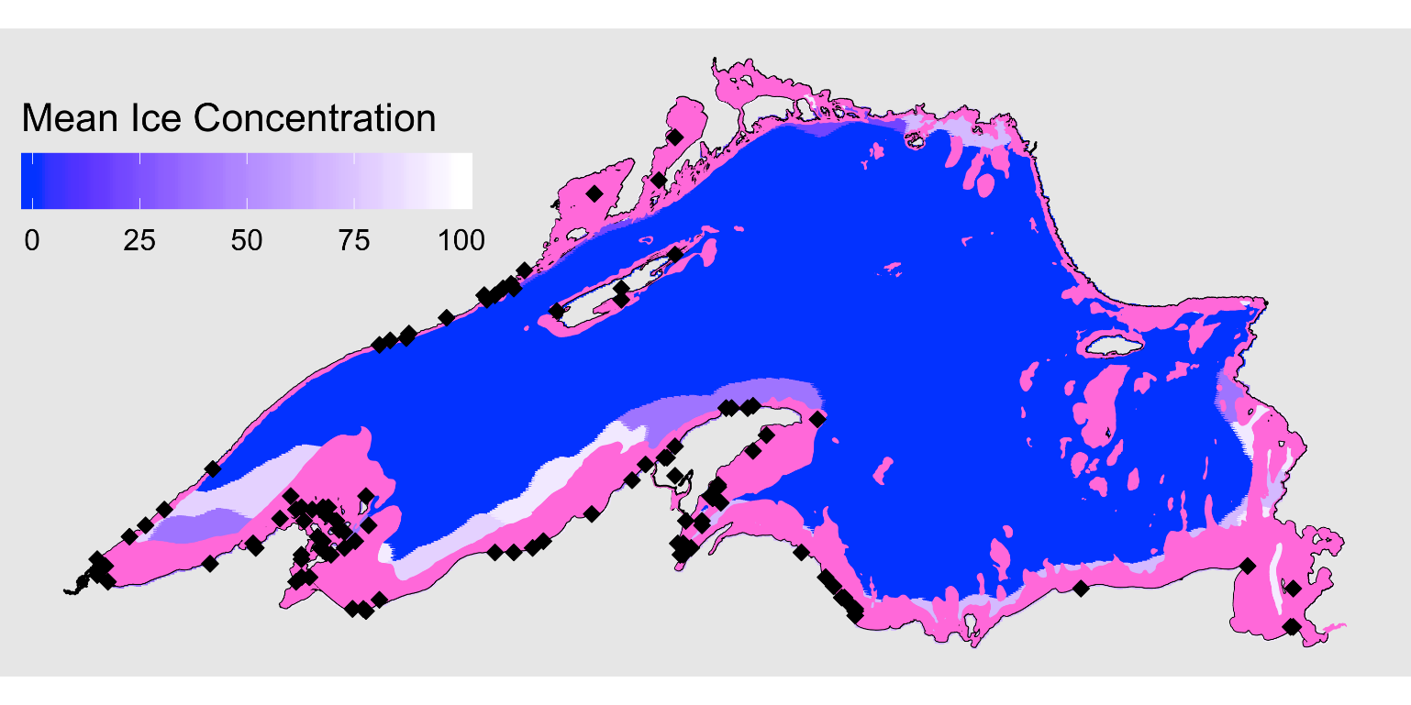
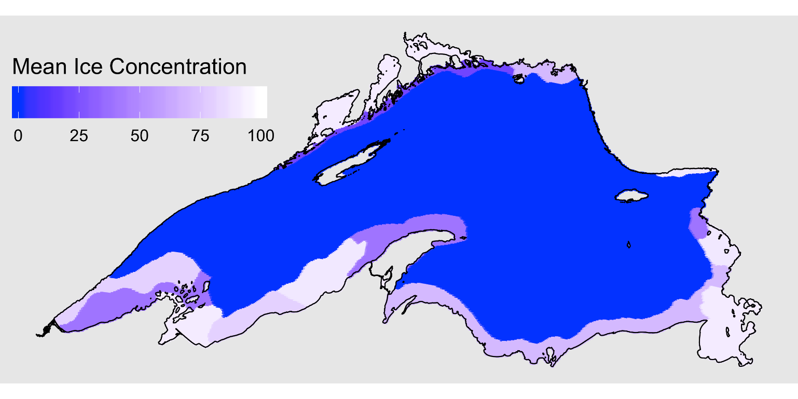
Causal Factors Influencing Cisco Recruitment
Regression tree analysis of the annual recruitment index over 38 years
None-Low recruitment
Low-moderate recruitment
High recruitment
19
12
7
FACTOR 1: Early Ice January ice cover <15% January ice cover >15%
Typical lakewide 15% January ice cover
90% of measurable recruitment events
Known Ciscoe spawning sites
100 m depth zone
Notes:
We have 38 years of recruitment and environmental data, 19 years were classified as none to low recruitment. 12 years recruitment was measurable, and recruitment was high in 7 years. The best first split in classification model was January ice cover, all but two of the moderate and high recruitment years occurred when lakewide January ice cover was >15% and 67% of the none to low recruitment years occurred when ice cover was <15% in January.
This map shows what 15% ice cover in January typically looks like based on NOAA ice classification of satellite images. The ice development pattern aligns well with the 100 m bathymetric depth. Coincidentally this level of ice cover would include nearly all of the know cisco areas which are shown here based on the Goodyear atlas.

Slide 10
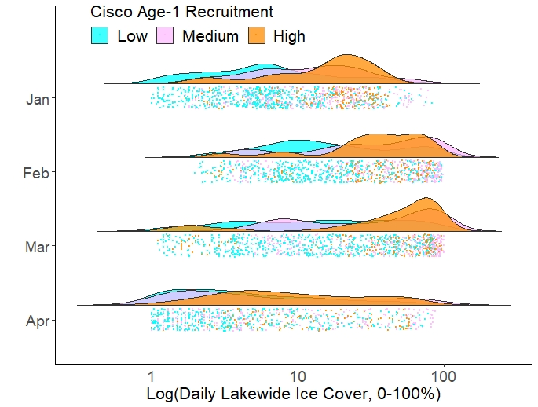
Cisco age-1 Recruitment and Ice Cover

Slide 11
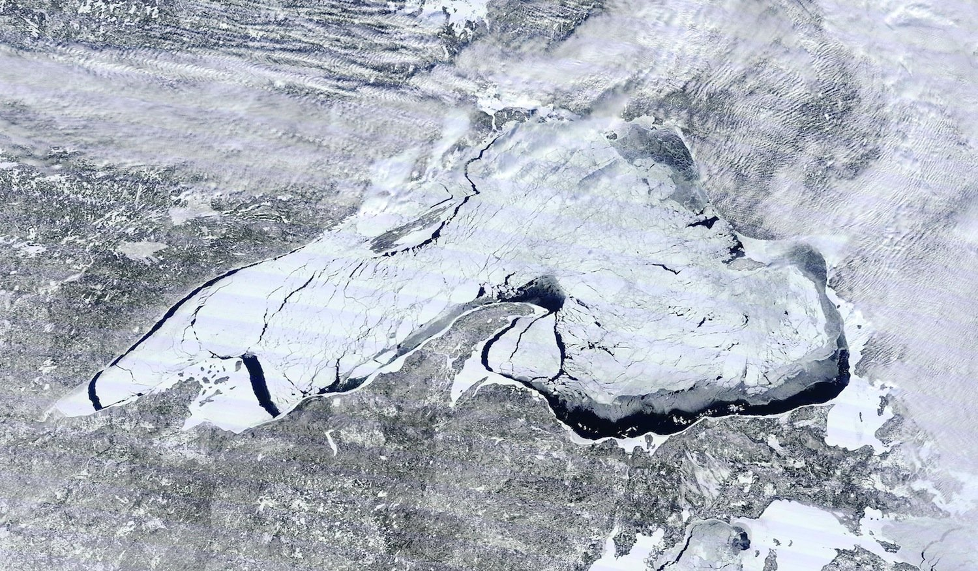
Why would ice be important?

Slide 12
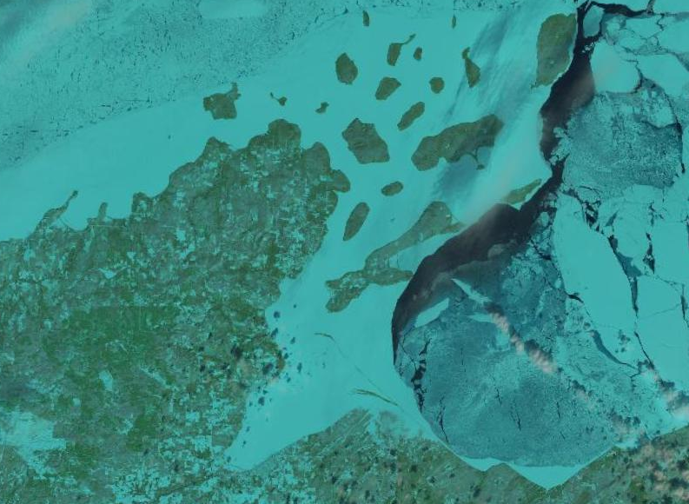
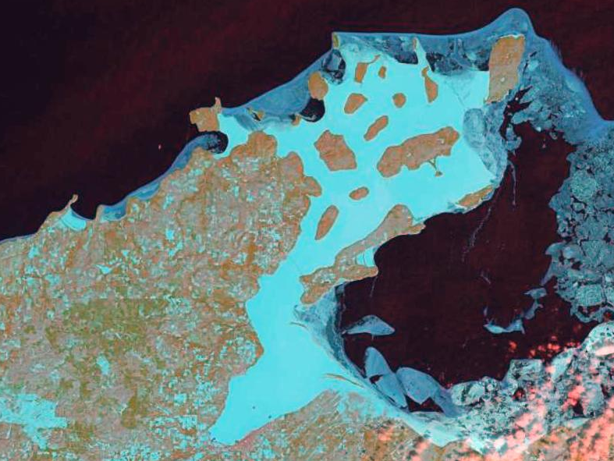
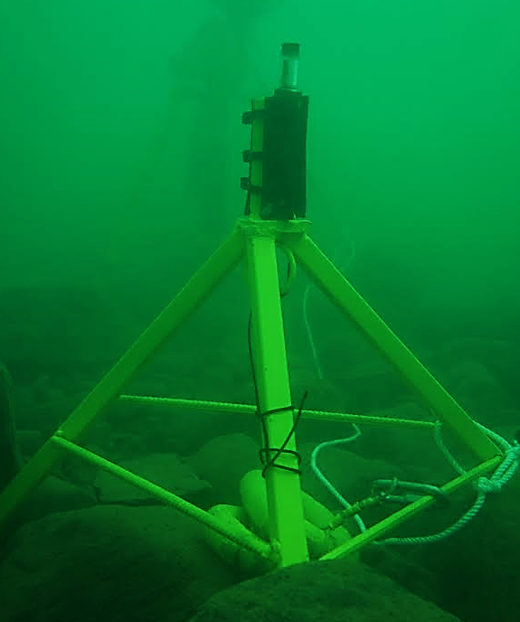
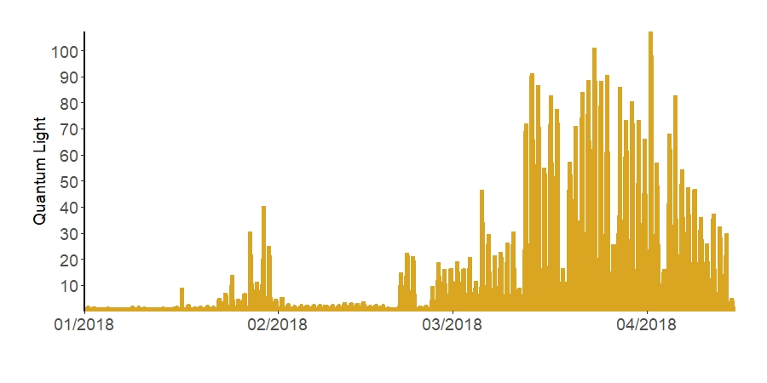
Ice and light
January-February
15 March 2018
High ice cover
No ice cover
Light Penetration to Sensor
Images from USGS LandSatLook. Light data from Sand Island, Lake Superior, Taylor Stewart University of Vermont
Notes:
This finding led us to think about what other factors early ice formation influences. Ice formation is obviously related to water temperature, but ice also has a direct effect on light. These are data from a light sensor that we deployed on the lake bottom near Sand Island in the Apostle Islands. Here is a LandSat image showing extensive ice cover in January-February and little to no light reaching the bottom as compared to the middle of March when ice left this area and light increased significantly.

Slide 13
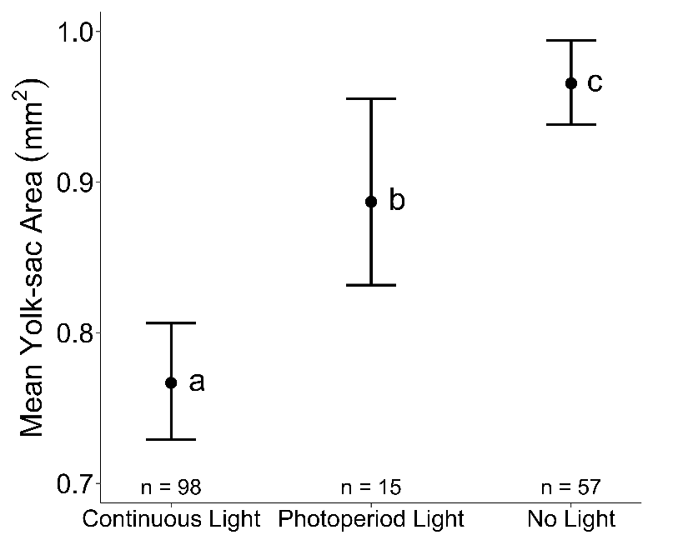



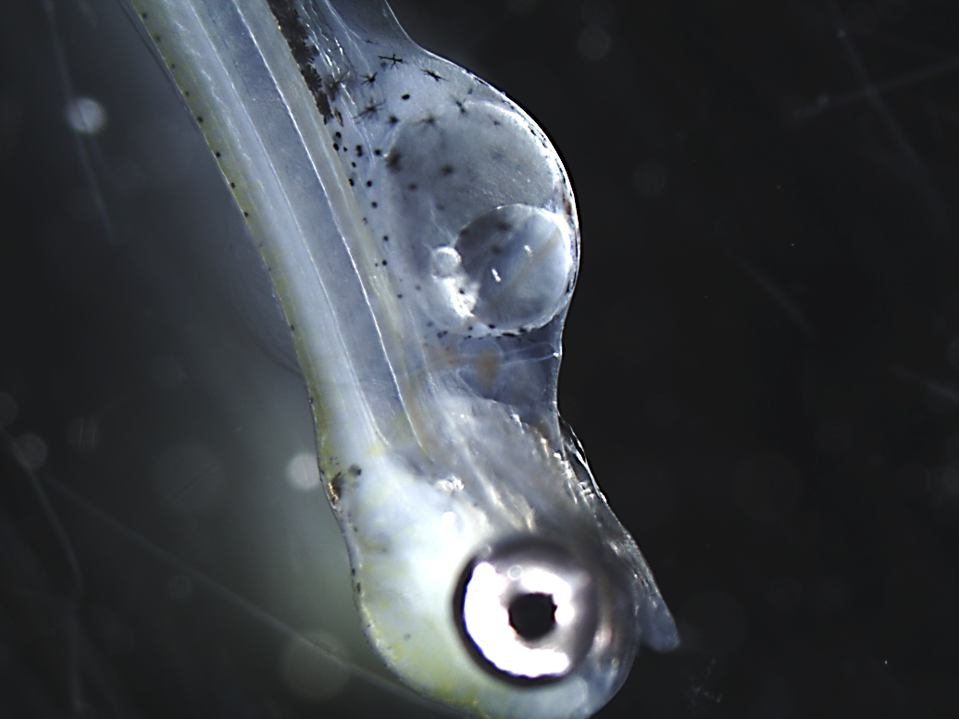
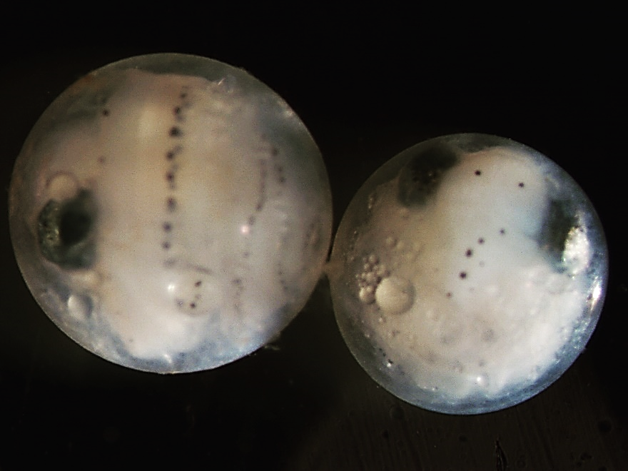
Two Potential Mechanisms Between Ice and Recruitment
Temperature – development rate
Light – development rate and energy stores
2014, Hatch May 14
2017, Hatch April 7
Egg development curve from Colby and Brooke 1973. Yolk-sac area and images from Taylor Stewart, University of Vermont
Notes:
Potential mechanisms between early ice and egg incubation and larval survival. One obvious one is that temperature effects egg incubation. The colder it is, the longer the incubation period. We have observed this in Lake Superior and have seen up to 40 day difference in hatch dates between high and low ice years. The plot on the right shows the relationship between light and yolk-sac area immediately after hatching. This work was done by Taylor Stewart at the University of Vermont. Eggs reared in darkness had significantly higher yolk-sac area than eggs raised in full or partial light. Yolk sac area at hatch has been related to larval survival, but more works need to be done.

Slide 14
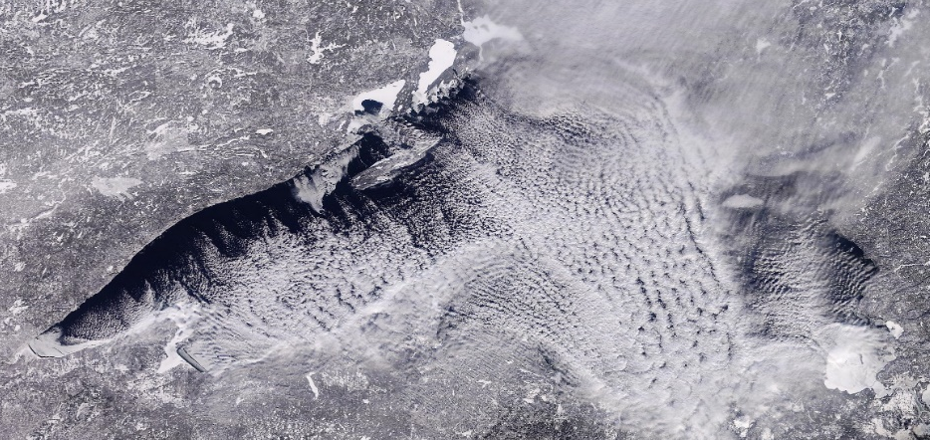

Trend in January Ice Cover
January ~15% ice cover
15%
Satellite image from UW-Madison. Ice data from NOAA GLERL
Notes:
After 1998, early ice cover has been much rarer and the recruitment events denoted with a star have only occurred when January ice has exceeded 15%.

Slide 15
Causal Factors Influencing Cisco Recruitment
Regression tree analysis of annual recruitment over 37 years
None-Low recruitment
Low-moderate recruitment
High recruitment
19
12
7
FACTOR 1: Early Ice January ice cover <15% January ice cover >15%
90% of measurable recruitment events
FACTOR 2: Spring warming July >7°C July <7°C
Notes:
The second branch in our analysis was July temperatures which we take as measure of spring water warming rates. 70% of high recruitment events occurred when July temperatures were <7.5C, so in years where lake warming was slow.

Slide 16

Cisco age-1 Recruitment and Water Temperature

Slide 17

Trend in July Water Temperature
7° C
Ice and water temperature data from NOAA GLERL

Slide 18


Forecast
Ciscoe populations will continue to decline without successful recruitment
Current climate trends may increase ice cover variability
Can intermittent polar vortex years sustain ciscoe populations?
The past
The future?
Years with >15% January ice decreased over the past 50 years
~30 day reduction in the number of days <32°F over the next 50 years
Cisco recruitment data from USGS nearshore surveys. Ice data from NOAA GLERL. Temperature forecast from Environmental Law and Policy Center

